Slide 1
Unit 2(Lesson 6,7 and 8)
(Break, Continue and Pass Statement)

Slide 2
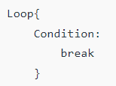
Python break Statement
The break statement terminates the loop containing it. Control of the program flows to the statement immediately after the body of the loop.
If break statement is inside a nested loop (loop inside another loop), break will terminate the innermost loop.
Syntax-

Slide 3
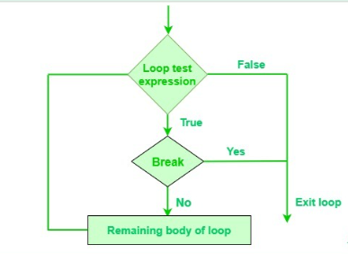
Working of break Statement

Slide 4
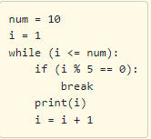
Example
Explanation:
once the condition
num % 5 == 0
evaluates to True the break statement is executed and it transfers the control out of the loop and further numbers are not printed.

Slide 5
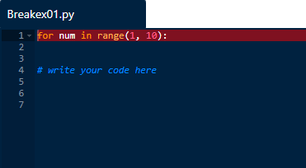
Practice Question
Fill the missing code in the below program to check the num is divisible by 5 or not. If the number is divisible by 5 break the program and print the number.

Slide 6
Solution
for num in range(1, 10):
if(num%5==0):
break
else:
print(num)

Slide 7
Practice Question
Take a character input from the user using input() function. Write a program to check the given input is a vowel or not. Print the result to the console as shown in the examples. Follow the below constraints while writing the program. If the input is an alphabet, then program should asks the user to enter the input again.
If the input is a digit other than 9, the program should print wrong input.
If the input is 9, the loop should terminate.

Slide 8
Solution
# Checking if the entered character is a vowel
vowels = "aeiouAEIOU"
while True:
char1 = input("vowel, or 9 to quit: ")
if char1.isalpha() or char1 == "9":
if char1 == "9" :
break
if char1 in vowels:
print("vowel")
else:
print("not vowel")
else:
print("wrong input")
continue

Slide 9
MCQ
i = 0
while i < 6:
i += 1
if i == 3:
break
print(i)
1 2 3
1 2
1
1 2 3 4 5 6

Slide 10
MCQ
i = 0
while i < 6:
i += 1
if i == 3:
break
print(i)
1 2 3
1 2
1
1 2 3 4 5 6

Slide 11
(Continue Statement)

Slide 12
Python continue statement:
The continue statement is used to skip the rest of the code inside a loop of the
current iteration. Loop does not terminate but continues with the next iteration.
Syntax of Continue
continue

Slide 13
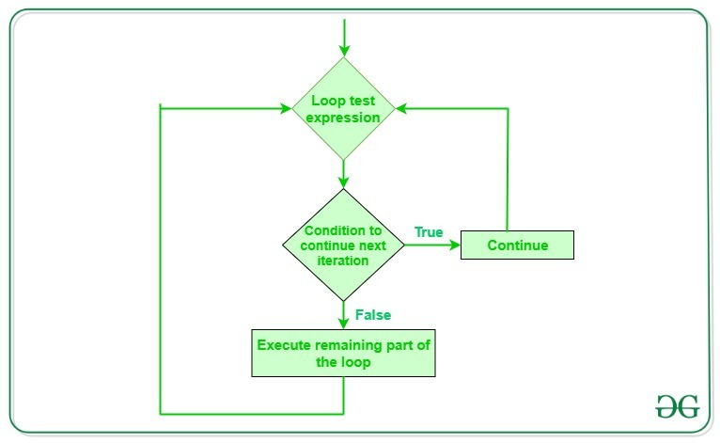

Slide 14
Example:
for num in range(1, 10):
if (num % 2 == 0):
continue
print(num)
The above code skips printing the even numbers and prints only the odd numbers.

Slide 15
Output:
i = 0 while i < 9: i += 1 if i == 3: continue print(i)
1 2 3 4 5 6 7 8 9
1 2 4 5 6 7 8 9
1 2 3 3 3 3 3 3

Slide 16
Output:
i = 0 while i < 9: i += 1 if i == 3: continue print(i)
1 2 3 4 5 6 7 8 9
1 2 4 5 6 7 8 9
1 2 3 3 3 3 3 3

Slide 17
Practice question:
Complete the following code:
for num in range(1, 20):
# skip all the numbers below and equal to 10
# print the numbers
print("The number is", )

Slide 18
Solution:
for num in range(1, 20):
if num<=10:
continue
print("num:", num )

Slide 19
Pass statement

Slide 20
Pass Statement
A pass statement in Python has no operation or a null operation statement and when encountered and executed nothing happens.
It is useful as a placeholder when a statement is required syntactically, but no code needs to be executed.
It is similar to a comments in Python, however comments are ignored by the interpreter whereas for pass statement it is not. It is still counted as a valid statement.
A good way to use pass is to hold the place of code that isn't ready or hasn't been written yet. Often it takes the place of loops or functions.
To use it, type the word pass where you would normally insert any other code (like a loop or a function)

Slide 21
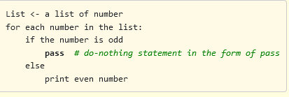
Write a program to print all even numbers from the list of numbers given below. Ignore all odd numbers using the pass statement

Slide 22
Pass statement can be used with conditional statements
a = 10
b = 20
if(a<b):
pass
else:
print("b<a")
Note: When the pass statement is executed, nothing happens, but you avoid getting an error when empty code is not allowed. Empty code is not allowed in loops, function definitions, class definitions, or in if statements.

Slide 23
Kindly note:
When the user does not know what code to write, So user simply places pass at that line. Sometimes, pass is used when the user doesn’t want any code to execute.
So user can simply place pass where empty code is not allowed, like in loops, function definitions, class definitions, or in if statements. So using pass statement user avoids this error.

Slide 24
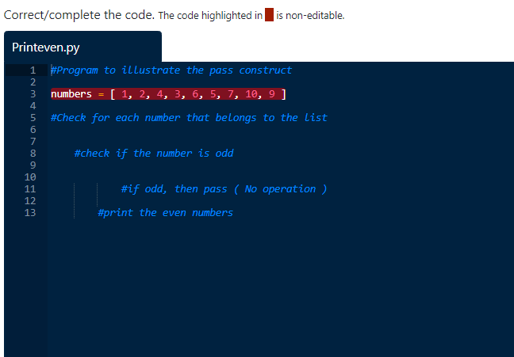

Slide 25
Solution:
#Program to illustrate the pass construct
numbers = [ 1, 2, 4, 3, 6, 5, 7, 10, 9 ]
for num in numbers:
if num%2!=0:
pass
else:
print (num)

Slide 26
Select the correct Python control statement:
Pass statement
Break statement
Continue statement
All of the above

Slide 27
Select the correct Python control statement:
Pass statement
Break statement
Continue statement
All of the above

Slide 28
Select the correct Statement
Pass is used when programmer don’t want to execute the code
Pass is a looping statement
Pass display nothing on screen
a and b
a and c
a, b and c
Only a

Slide 29
Select the correct Statement
Pass is used when programmer don’t want to execute the code
Pass is a looping statement
Pass display nothing on screen
a and b
a and c
a, b and c
Only a

